Slide 1
Logistic Regression

Slide 2
When And Why
To explain an outcome variable that is categorical (dichotomous)
Yes/No, Liberal/Conservative,
Used because categorical outcome violates the assumption of linearity in OLS
We’re trying to predict the probability of membership in one category (1) over the other (0).

Slide 3
Why not Linear Regression?
Probabilities are constrained between 0 and 1
If we wanted to explain a person’s probability of protest participation (0 = no, 1 = yes), we could write in OLS form:
p = b₀ + b₁X₁ + b₂X₂ + e
Where X₁ is sex and X₂ is race
If women are coded as 1, and whites are coded as 1
If…
b0 = -2.3
b1 = .54
b2 = .21
What is p for a white woman?
Notes:
-2.3 + .54. + .21

Slide 4
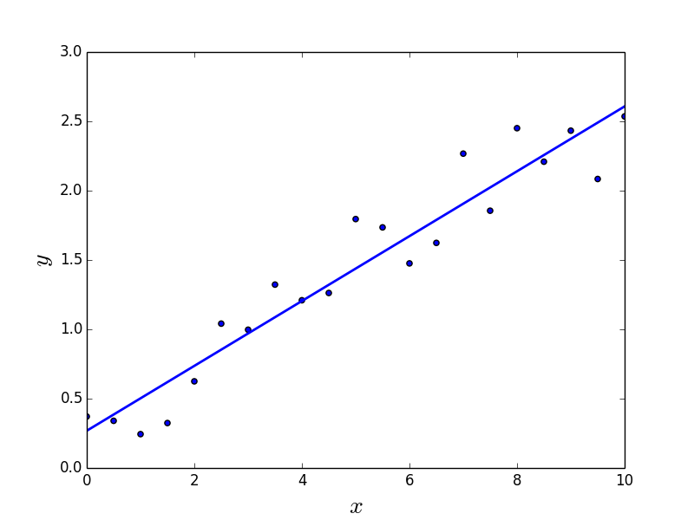
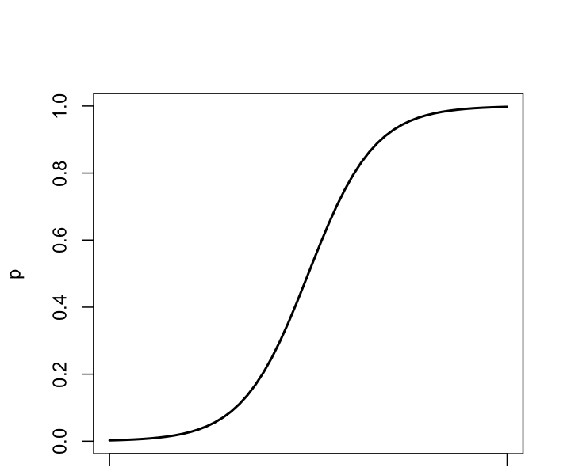
We have to find a way to constrain…

Slide 5
With One Predictor
Outcome
We predict the probability of the outcome occurring
b₀ and b₁
Same as in multiple regression
Logistic regression equation includes OLS equation

Slide 6
With Several Predictors
Outcome
We predict the probability of the outcome occurring
b₀ and b₁
Same as in multiple regression
Logistic regression equation includes OLS equation

Slide 7
Assessing the Model: the log-likelihood statistic
The Log-likelihood statistic
Analogous to SS_{E} (SS_{R}) in OLS regression
Indicates how much unexplained information there is after the model has been fitted.
Large values indicate poorly fitting models.
Notes:
Smaller numbers are better, -2 to make positive

Slide 8
Assessing the Model: Deviance or -2LL
The deviance is very closely related to the log-likelihood:
Deviance = −2 × log-likelihood
Since log-likelihood will always be negative, we multiply it by a negative number to get a positive
Double it to make a X2 distributed value
It’s possible to compare models by looking at difference between their deviances.
Notes:
New == final, baseline == null

Slide 9
Assessing the model: R²

Slide 10

Assessing Predictors: The Wald Statistic
$$Wald X^{2}= {(\frac{b}{{SE}_{b}})}^{2}$$
Similar to t-statistic in OLS
Tests the null hypothesis that b = 0
Is biased when b is large
Better to look at Likelihood-ratio statistics.
Notes:
In R, it reports a Z-statistic, because this statistic is based off a t-test, and z is the standardized version…. So just square it.

Slide 11
The odds ratio: exp(b)
exp(b) = exponentiate the b coefficient
Indicates change in odds of outcome resulting from a unit change in the predictor.
OR > 1: ↑ in predictor, ↑ probability of outcome
OR < 1: ↑ in predictor, ↓ probability of outcome

Slide 12
Interpreting Odds Ratios
Calculate percent change in Y as for a 1-unit increase in X
[exp(b) - 1] * 100
Race exp(b) = 1.57
[1.57-1]*100 = 57%
A one-unit increase in race is associated with a 57% increase in Y
SES exp(b) = .39
[.39-1]*100 = -61%
A one unit increase in SES is associated with a 61% decrease in Y

Slide 13
An Example
Explaining whether or not patients were cured
Participants
113 adults with a medical problem
Outcome:
Cured (1) or not cured (0).
Predictors:
Treatment: received treatment or not
Duration: number of days before treatment patient had the problem

Slide 14
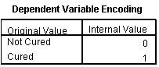
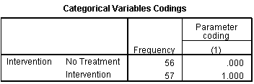
Output: Initial Model

Slide 15
Output: Initial analysis

Slide 16
Output: Block 0

Slide 17
Output: Model Summary

Slide 18
Output: Model Summary

Slide 19
Model Summary

Slide 20
Potential Problem: Overdispersion
Variance is larger than expected from the model
Can be caused by violating the assumption of independence
makes standard errors too small

Slide 21
Things That Can go Wrong
Unique Problems to Logistic
Incomplete Information
Complete Separation
Overdispersion

Slide 22
Summary
The overall fit of the final model is shown by −2LL and its associated chi-square statistic.
If the significance of the chi-square statistic is less than .05, then the model is a significant fit of the data.
Look at the Wald statistic and its significance for each variable.
Use the odds ratio, exp(b), for interpretation.
OR > 1, then as predictor increases, the odds of the outcome increases
OR < 1, then as predictor increases, the odds of the outcome decreases
The confidence interval of exp(b) should not cross 1.
Notes:
Parsimony and why S-curve is important for binary outcomes

Slide 23
Reporting Logistic Regression
Model Fit Statistics
Nagelkerke’s R² = R²-value; Indicates that R²-percent percent of variance in Y is explained X/the variables
The Chi-Square statistics indicates that the overall model significantly/did not significantly explained Y better than the null model (with no predictors), X²(df) = X²-value, p-value
Each Predictor’s/IV’s exp(b), if significant, and the direction of the relationship
X₁ was significantly/not significantly related to the Y; every one-unit increase in X₁ was associated with a |[exp(b) - 1]*100|-percent increase/decrease in Y (exp(b₁) = value, Wald X²(1) = X²-value, p-value).
The model yielded a Nagelkerke’s R² = .335; indicating that 33.5 percent of the variance in album sale revenue can be explained by the variance in advertising budget. The omnibus chi-square test indicates that the overall model significantly predicted album sale revenue, X²(199) = 99.587, p < .001 better than the null model with no predictors. Advertising budget was significantly related to the outcome; every one-unit (pounds) increase in budget was associated with a 9.6 percent increase in album sale revenue (exp(b) = .096, X₂(199) = 9.979, p < .001).

Slide 24
ICE# 9: GSS: Death Penalty for Murder?
Run a logistic regression to explain whether or not a person favors or opposes the death penalty
Run all predictors together
Fully and correctly interpret the model (Fit statistics, exponentiate and interpret the coefficients)
Y is cappun
1 = yes, 2 = no
Recode: 1 = yes, 0 = no
X₁ is race
1 = white, 2 = black, 3 = other
Recode: 1 = white, 0 = non-white
X2 is polviews
Scale: 1 = liberal -> -> -> 7 = conservative

